Slide 1
Good enoguh CNC plasma cutter – Assembly instructions
By Insitute IRNAS

Slide 2
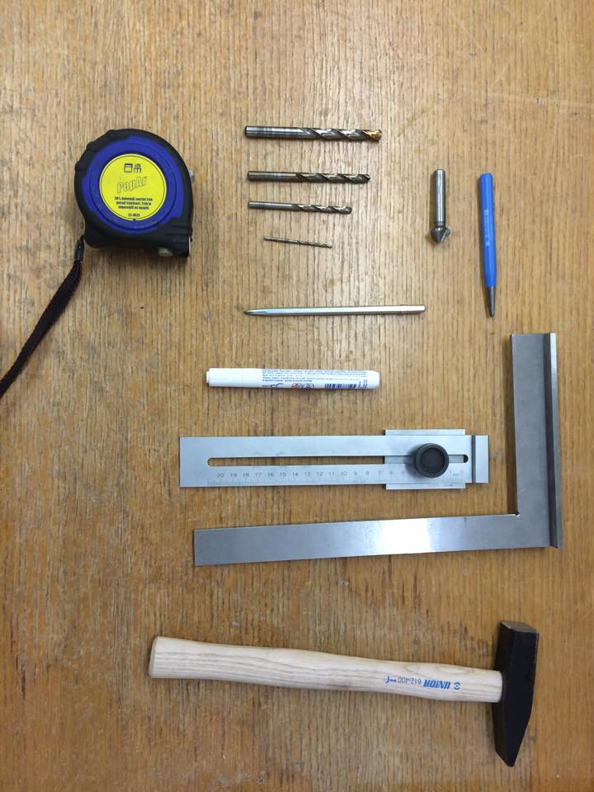
Guide for drilling holes
Drilling
For precise drilling of (through both walls) holes
in square beams please follow this steps.
Tools:
Scribe for marking lines,
Basic ruler,
Machinist's square,
Center punch,
Amateur drill press,
Hammer,
Edge smoother

Slide 3
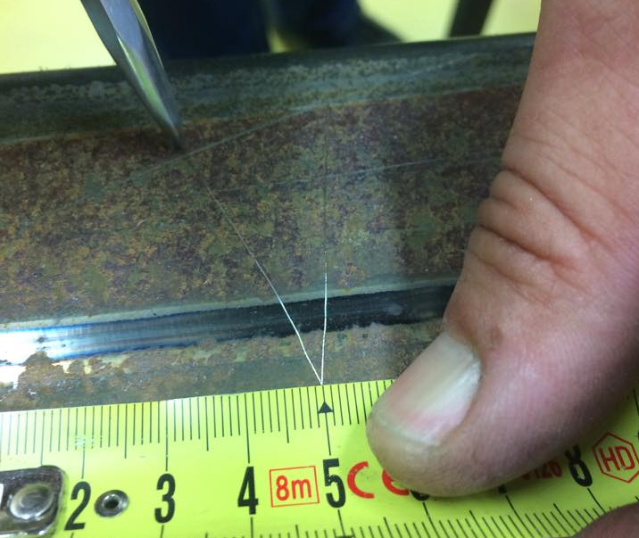
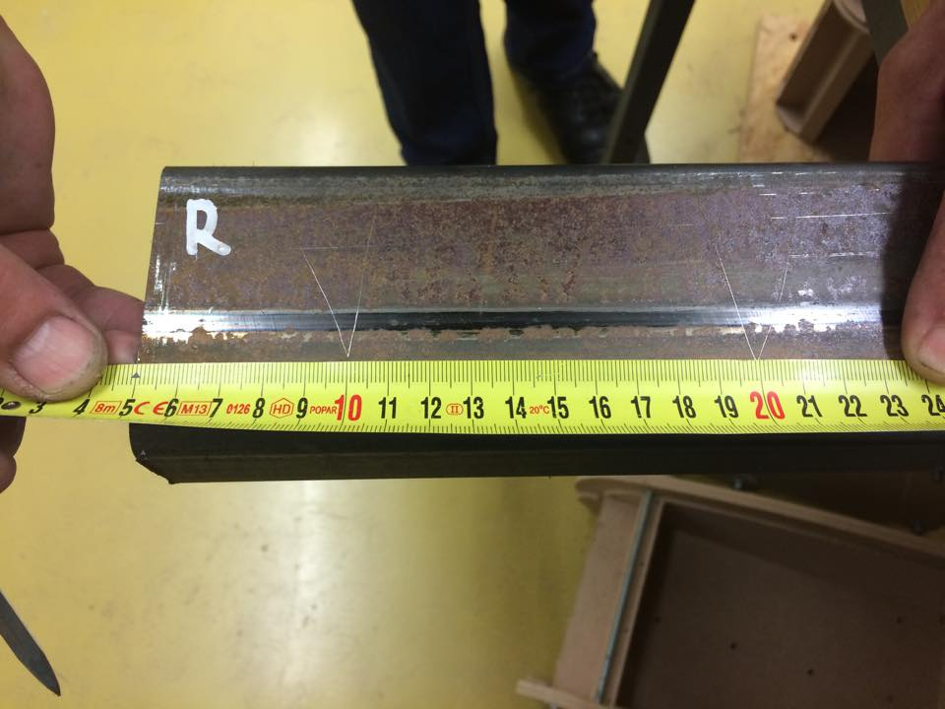
1. With ruler measure distance from reference point to center of the hole in both X and Y axis.
2. With scribe mark center of the hole.

Slide 4
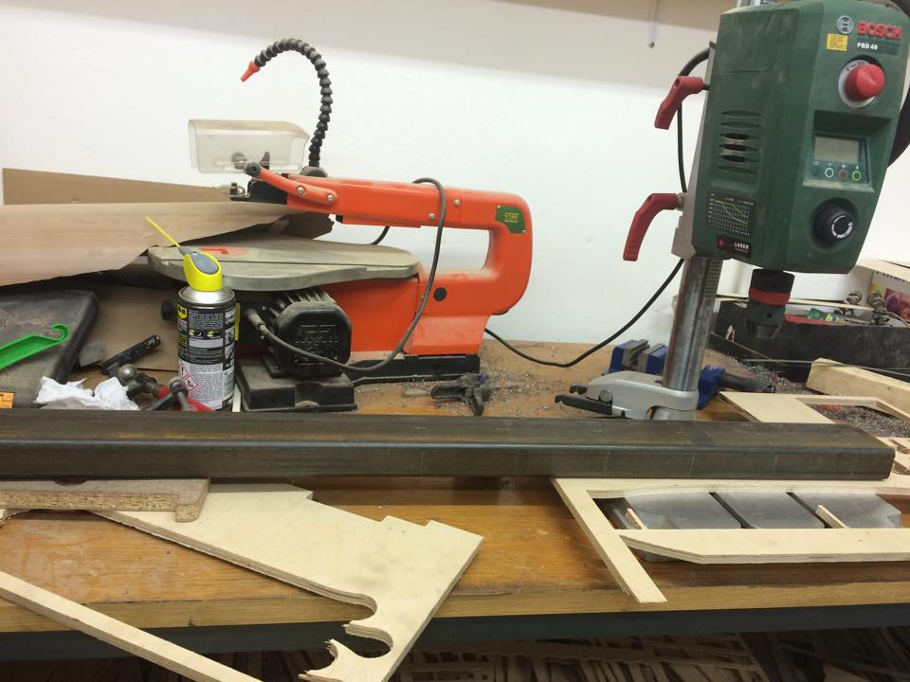
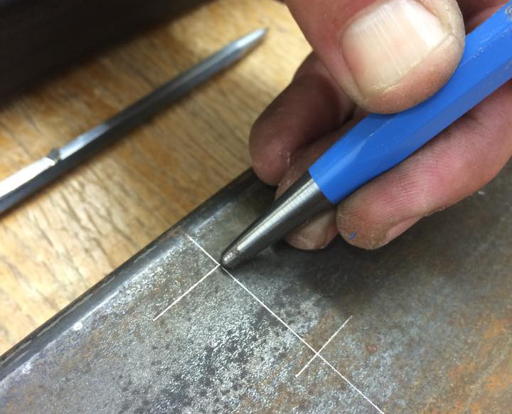
3. With center punch and hammer mark center of the hole on top surface. First use little force to check if center punch is positioned correctly. With stronger punch then make dent that will serve as guide for drill.
4. With center punch and hammer mark center of the hole on bottom surface. First use little force to check if center punch is positioned correctly. With stronger punch then make dent that will serve as guide for drill.
5. For 8mm diameter holes we must done predrill with smaller drills. The drilling is performed by stages on drill pres. Before drilling make sure that beam is rectangular to the drilling head.

Slide 5
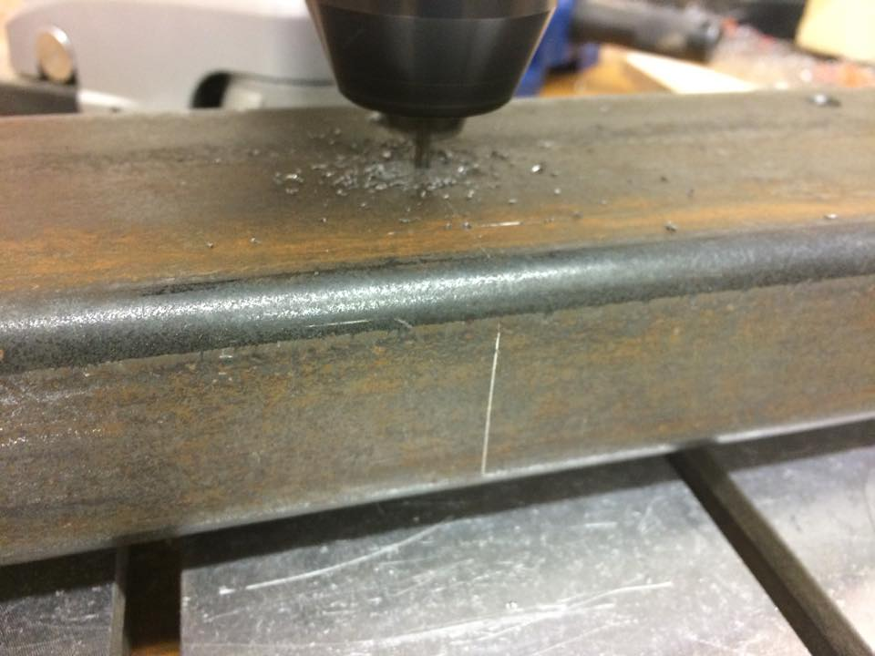
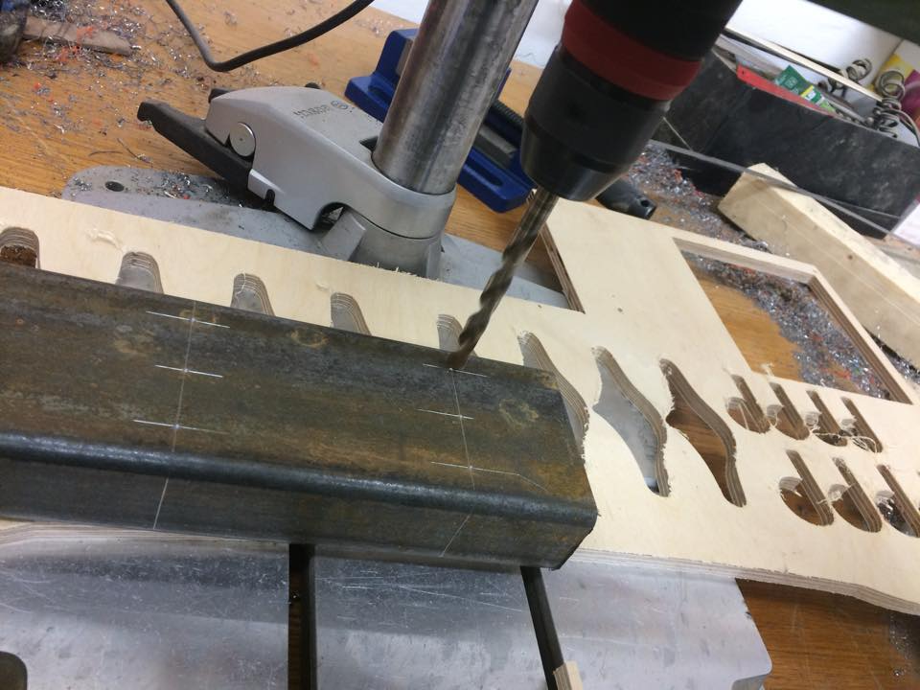
6. Start with 2,5mm hole, first drilll hole through top surface then through bottom surface.
7. Continue with drilling 5,5 mm hole, first drilll hole through top surface then through bottom surface.
8. Continue with drilling 6,5 mm hole, first drilll hole through top surface then through bottom surface.

Slide 6
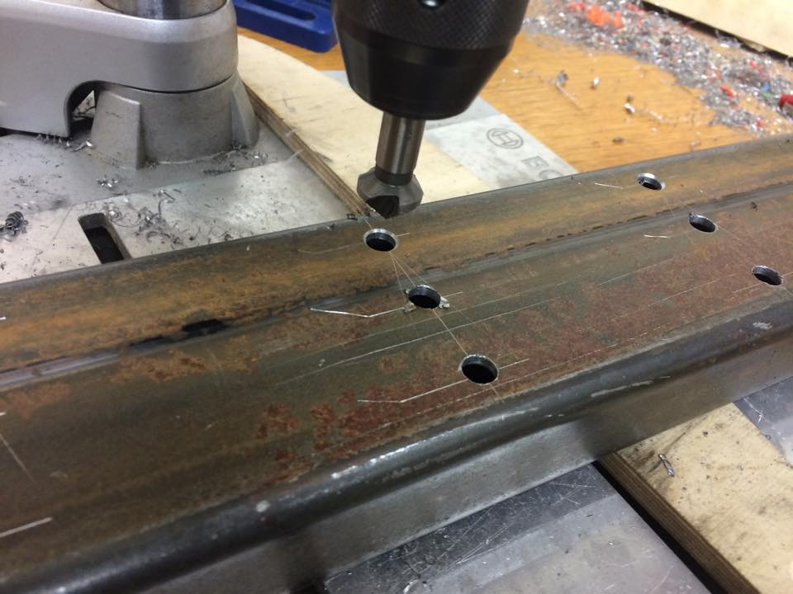
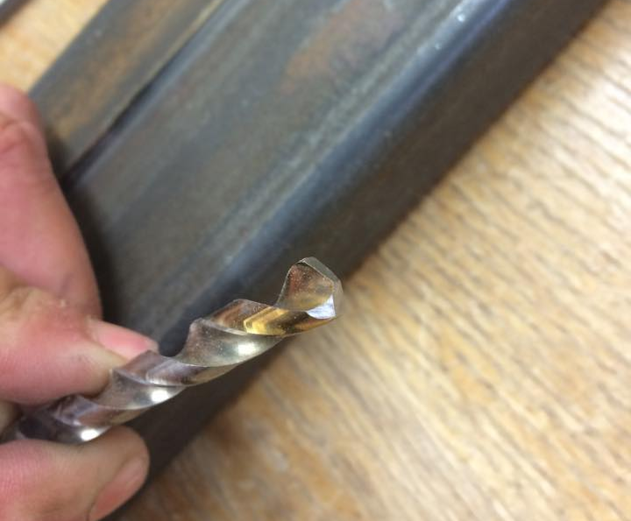
9. Finish with drilling 8 mm hole, first drilll hole through top surface then through bottom surface.
10. Smooth edges of the holes.

Slide 7
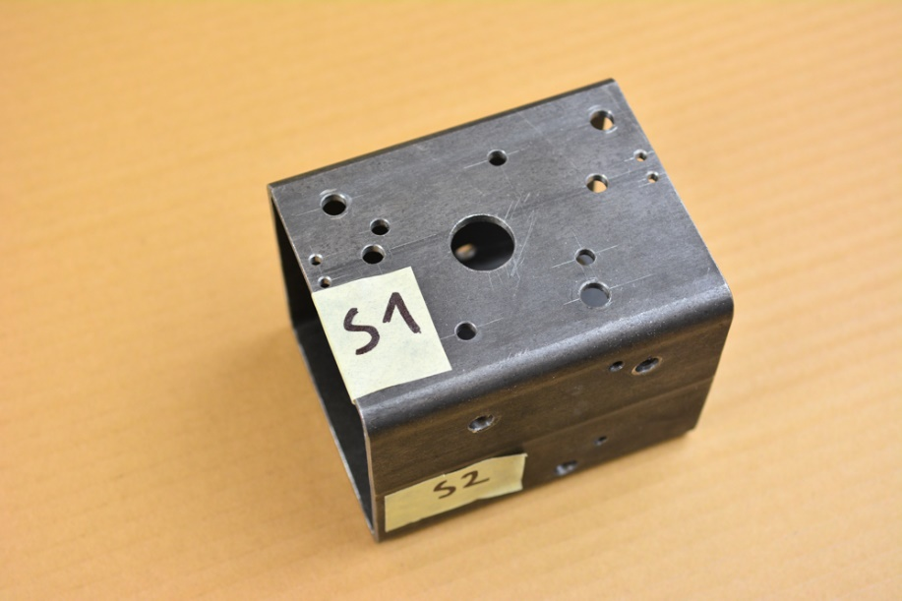
1. Parts Preparation 1.1 Preparing profiles for trolleys
3. Start marking positions of holes, begin on surface S1. Be sure that surfaces will follow as shown on drawings. Use hole table on drawing to see position and size of the holes. Always measure distance of the holes from the left bottom corner – from origin of the coordinate system for each surface. For positioning and drilling of the holes refer to guide for drilling holes!
1.1.1 Beam for trolley
Quantity: 3 pieces
Technical drawing: Beam Short
Use technical drawings for production of all parts.
1. Take square profile dimensions 100x100mm with 3 millimeters thick wall. Use saw to cut it 130 mm long. Be sure that rectangular cut is achieved.
2. Mark sides of profile as shown on drawing (technical drawing – Beam short X0). Start with S1 surface (surface onto which motor will be mount) and rotate it clockwise and mark sides S2, S3 and S4. Be sure that profile is oriented in the way that the more accurate cut is on the left side of your view – because the origin of coordinate system is positioned on the left bottom corner – see technical drawing.

Slide 8
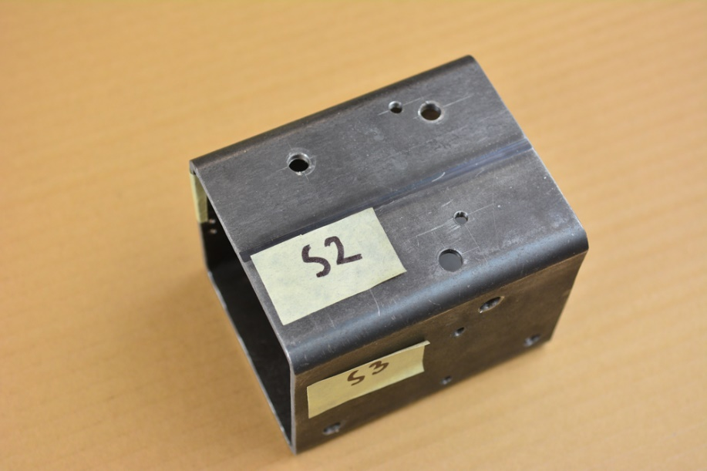
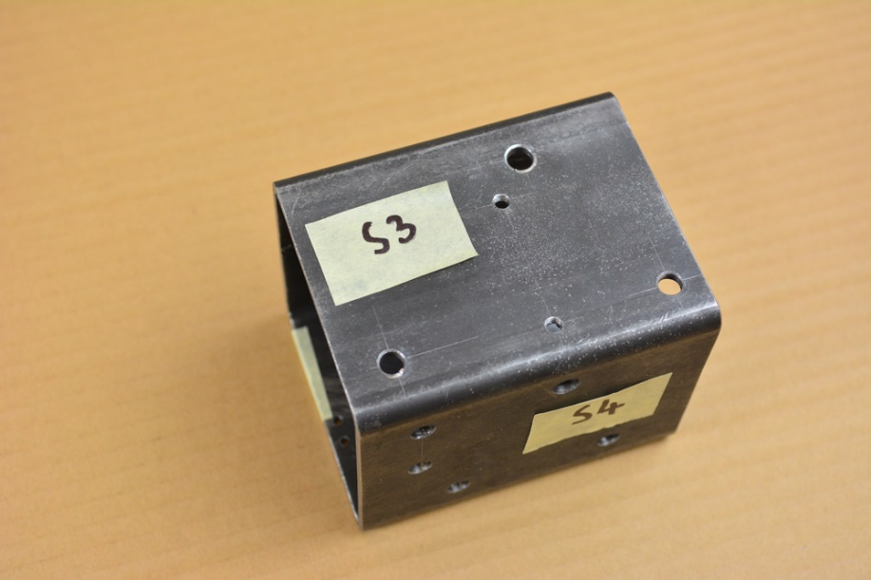
4. Position, mark and drill holes on surface S2
5. Position, mark and drill holes on surface S3

Slide 9
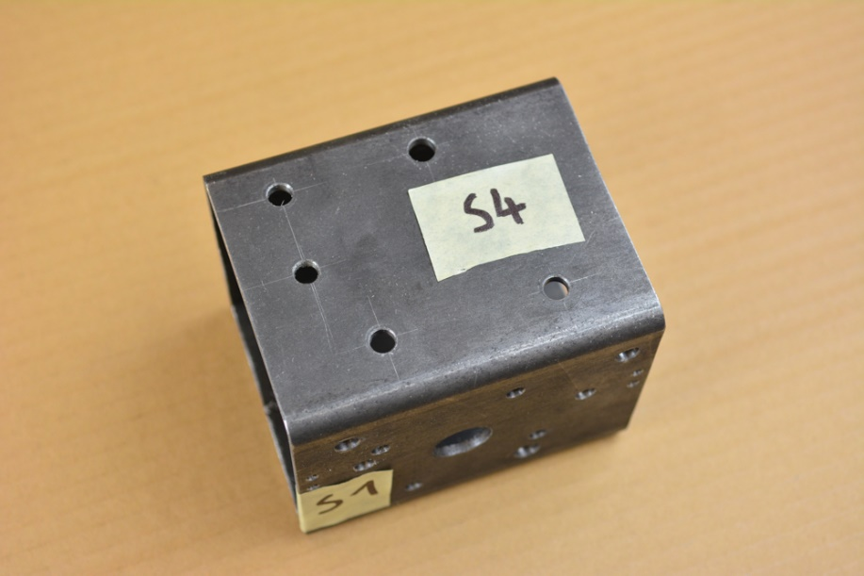
6. Position, mark and drill holes on surface S4

Slide 10
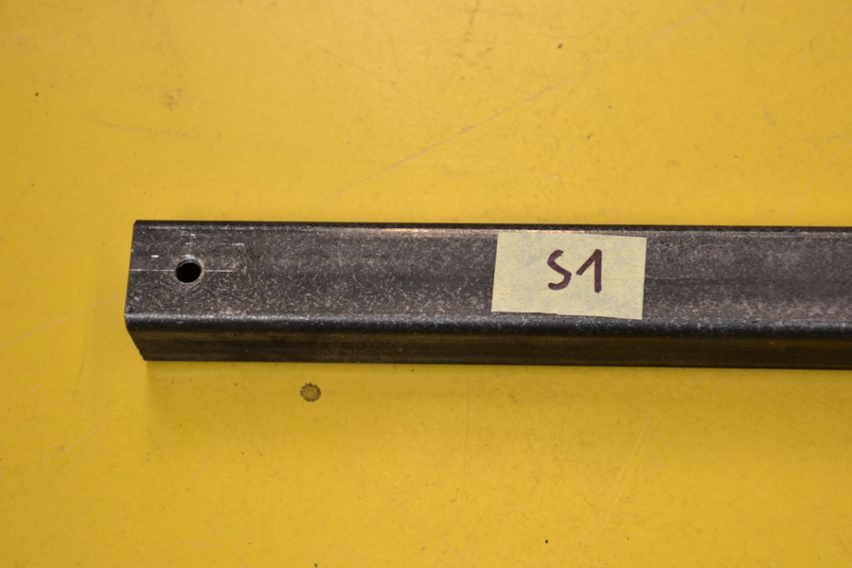
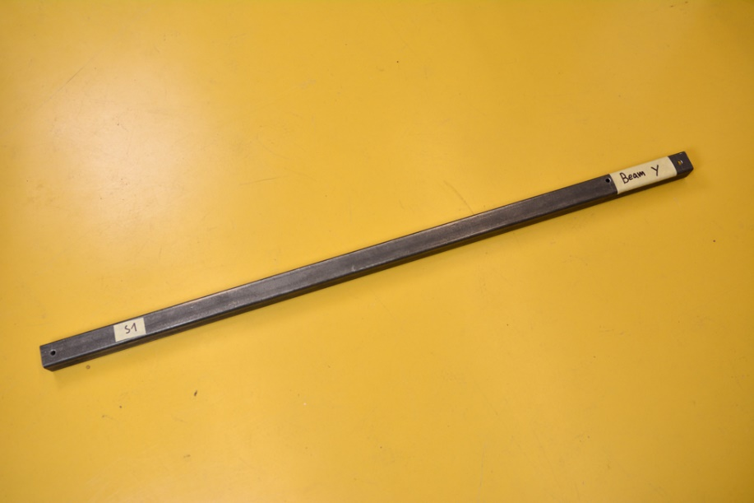
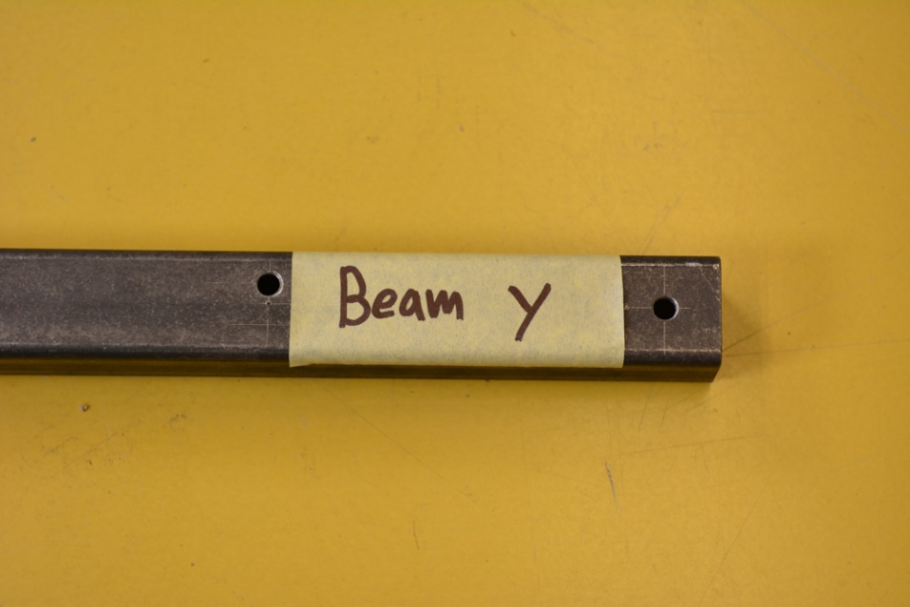
1.2 Preparing profiles for frame
3. Drill holes A1, A2 through both sides of profile on surface S1 and S3 and B1 through surface S1 as shown in drawing.
1.2.1 Beam Y
Quantity: 2 pieces
Technical drawing: Beam Y
1. Start with cutting square profile dimensions 40mmx40mm 3mm thick to length 1200mm. Make sure to follow cutting/sawing rules described in guide for cutting and sawing.
2. Mark Surfaces of profile, start with S1 and rotate profile clockwise and mark sides S2, S3 and S4.

Slide 11
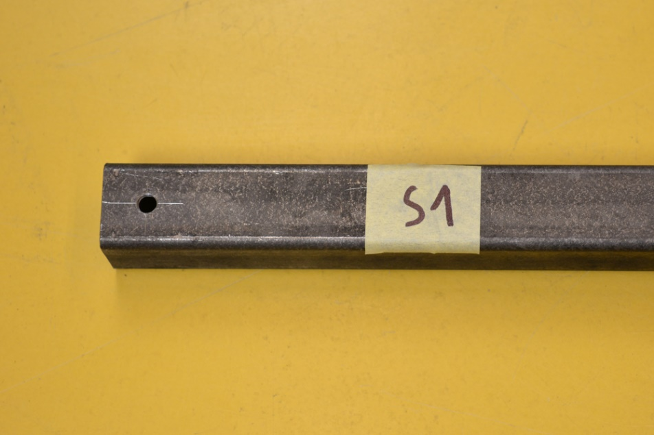
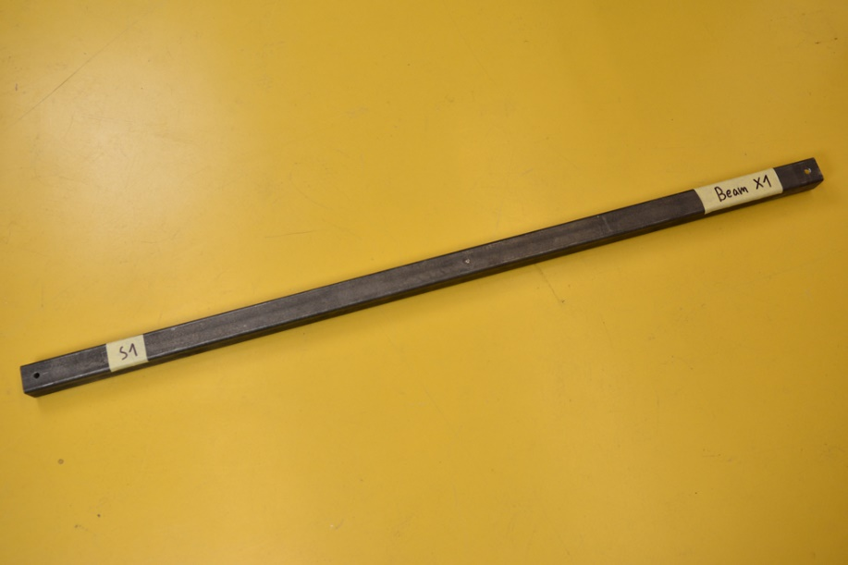
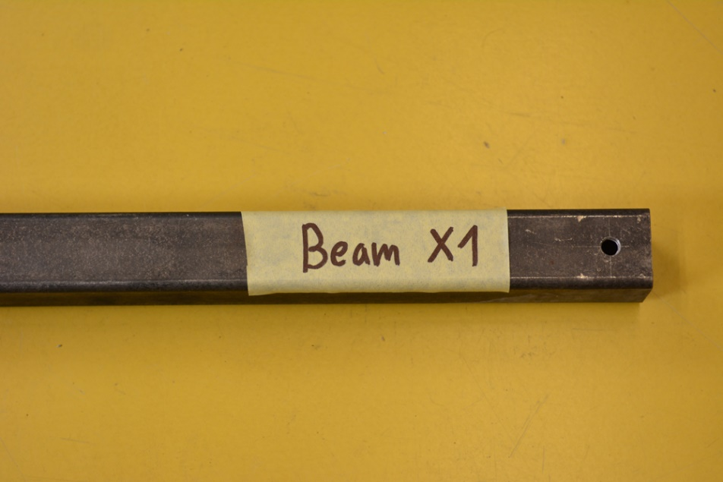
1.2.2 Beam X1
Quantity: 1 piece
Technical drawing: Beam X1
1. Cut square profile dimensions 40mmx40mm 3mm thick to length 1200mm.
2. Drill holes A1 and A2 through both sides of the profile (Surface S1 and S3) as shown in drawing.

Slide 12
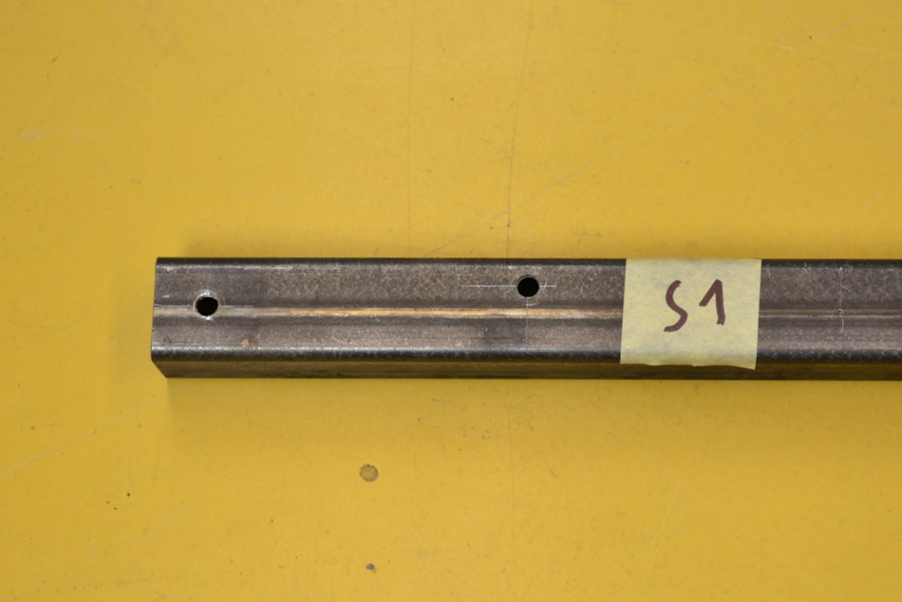
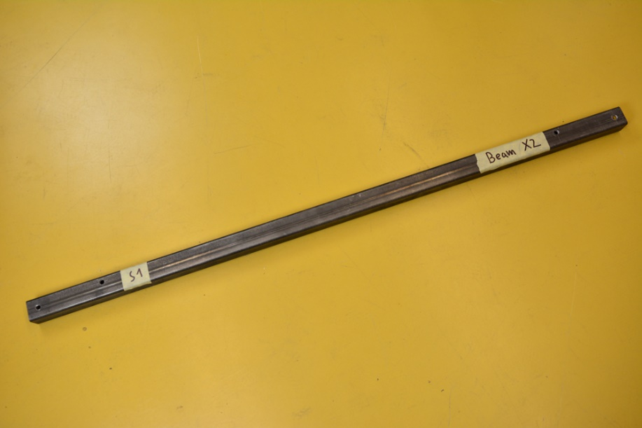
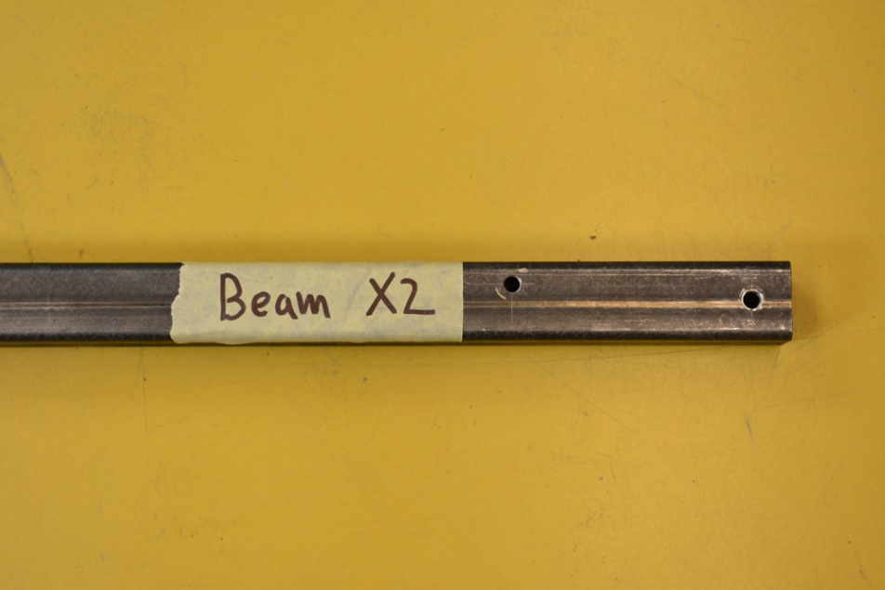
1.2.3 Beam X2
Quantity: 1 piece
Technical drawing: Beam X2
1. Cut square profile dimensions 40mmx40mm 3mm thick to length 1200mm.
2. Drill holes A1 and A2 through both sides of the profile (Surface S1 and S3) as shown in drawing.

Slide 13
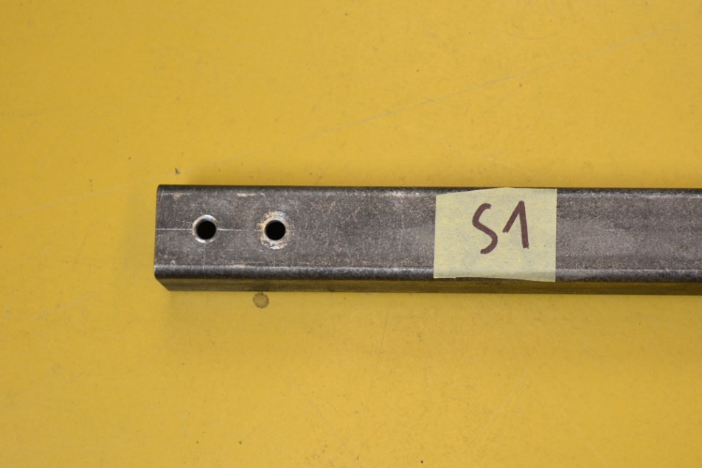
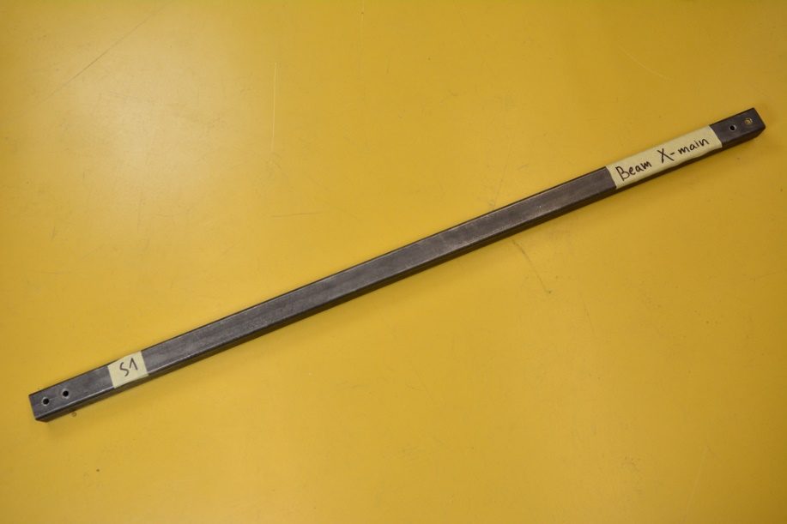
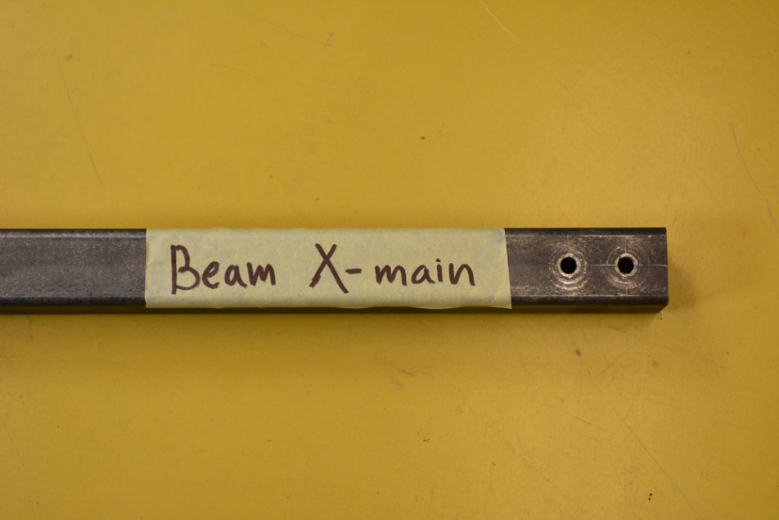
1.2.4 Beam X - Main
Quantity: 1 piece
Technical drawing: Beam X - Main
1. Cut square profile dimensions 40mmx40mm 3mm thick to length 1200mm.
2. Drill holes A1 and A2 through both sides of the profile (Surface S1 and S3) as shown in drawing.

Slide 14
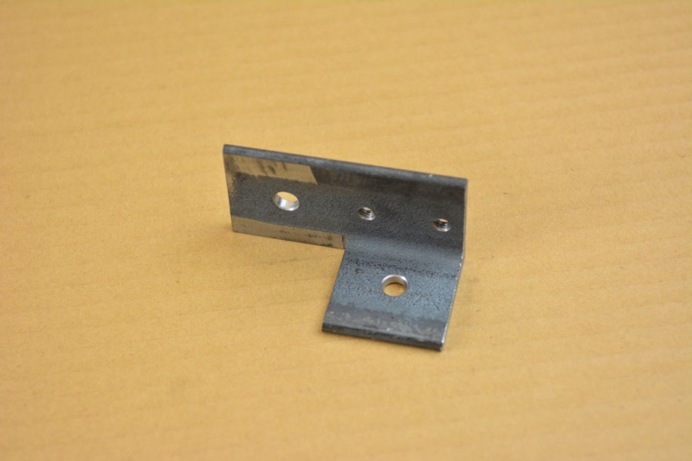
1.2.5 Bracket for tighteners - left
Quantity: 3 pieces
Technical drawing: Bracket for tighteners - left
1. Take L – profile dimensions 40x40mm, 3mm thick and cut it to length 80mm.
2. Cut 40mm long and 40mm wide notch on surface S2 like shown in technical drawing.
3. Drill one 8mm, two 6mm hole through the S1 surface.
4. Drill one 8 mm hole on surface S2.

Slide 15
1.2.6 Bracket for tighteners - right
Quantity: 3 pieces
Technical drawing: Bracket for tighteners - right
1. Take L – profile dimensions 40x40mm, 3mm thick and cut it to length 80mm.
2. Cut 40mm long and 40mm wide notch on surface S2 like shown in technical drawing.
3. Drill one 8mm, two 6mm hole through the S1 surface.
4. Drill one 8 mm hole on surface S2.

Slide 16
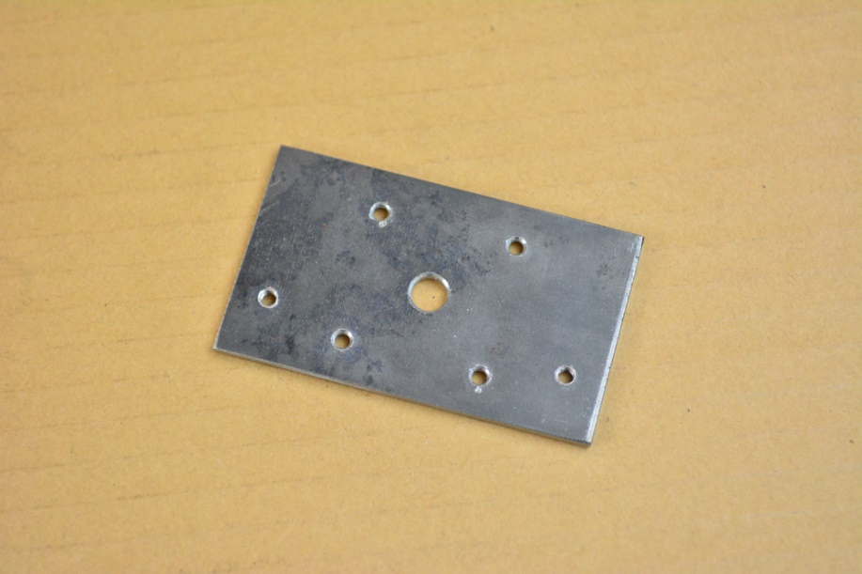
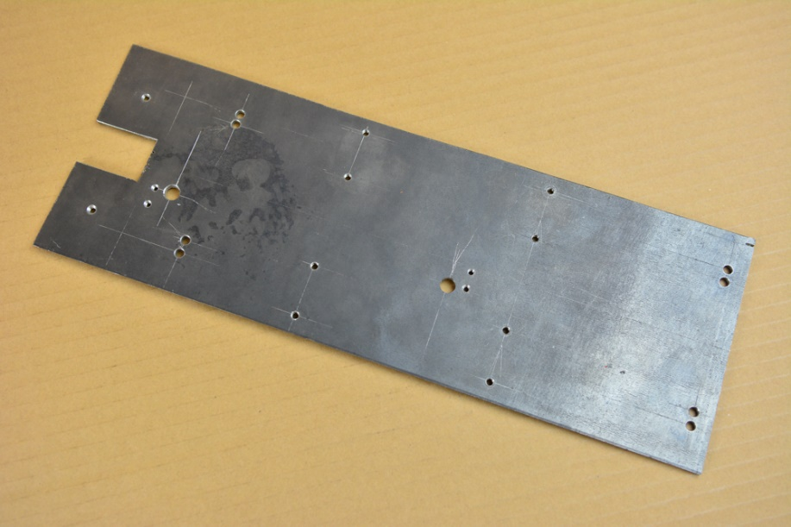
1.3 Preparing plates for Z axis
1.3.2 Motor mount
Quantity: 1 piece
Technical drawing: Motor mount
1. With angle grinder, cut 3mm thick metal plate dimensions 85x50mm.
2.Measure, mark and drill 3.2, 4.2 and 12mm hole, refer to drawing for dimensions.
1.3.1 Base plate
Quantity: 1 piece
Technical drawing: Base plate
1. With angle grinder, cut 3mm thick metal plate dimensions 430x130mm.
2. Cut out pocket, 42 mm wide and 40mm deep as shown in drawing.
3. Drill holes A1, A2 through both sides of profile on surface S1 and S3 and B1 through surface S1 as shown in drawing.

Slide 17
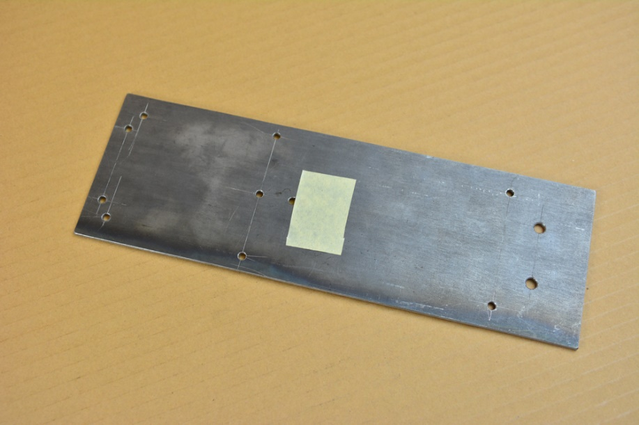
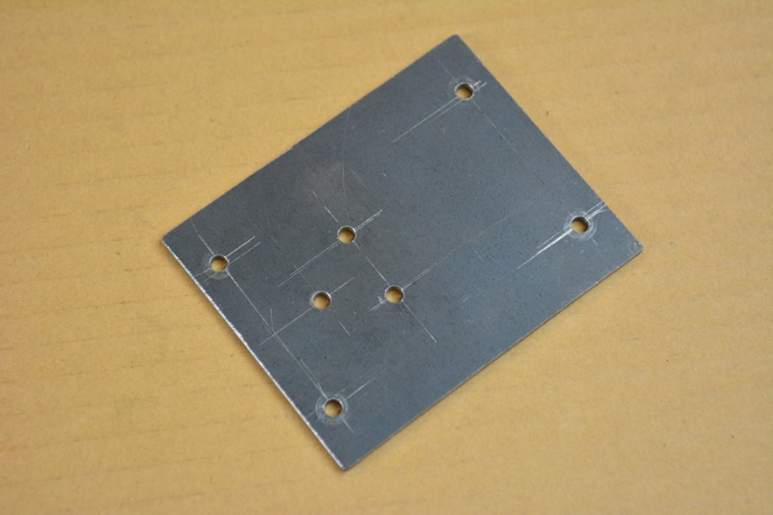
1.3.3 Mounting plate for small guides
Quantity: 1 piece
Technical drawing: Mounting plate for small guides
1. With angle grinder, cut 3mm thick metal plate dimensions 280x100mm.
2. Measure, mark and drill 3.5, 4.2 and 6mm holes, refer to drawing for dimensions.
1.3.4 Fixing plate
Quantity: 1 piece
Technical drawing: Fixing plate
1. With angle grinder, cut 3mm thick metal plate dimensions 80x60mm.
2.Measure, mark and drill 4.2 and 5.2mm holes, refer to drawing for dimensions.

Slide 18
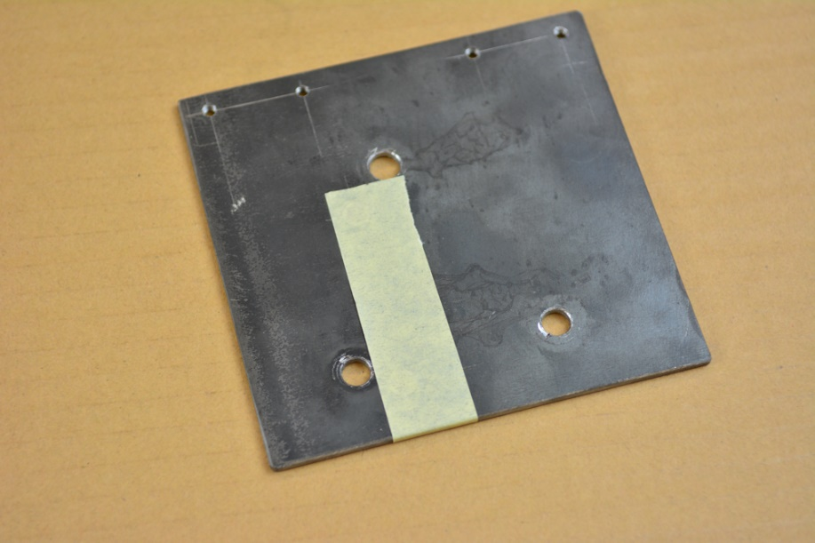
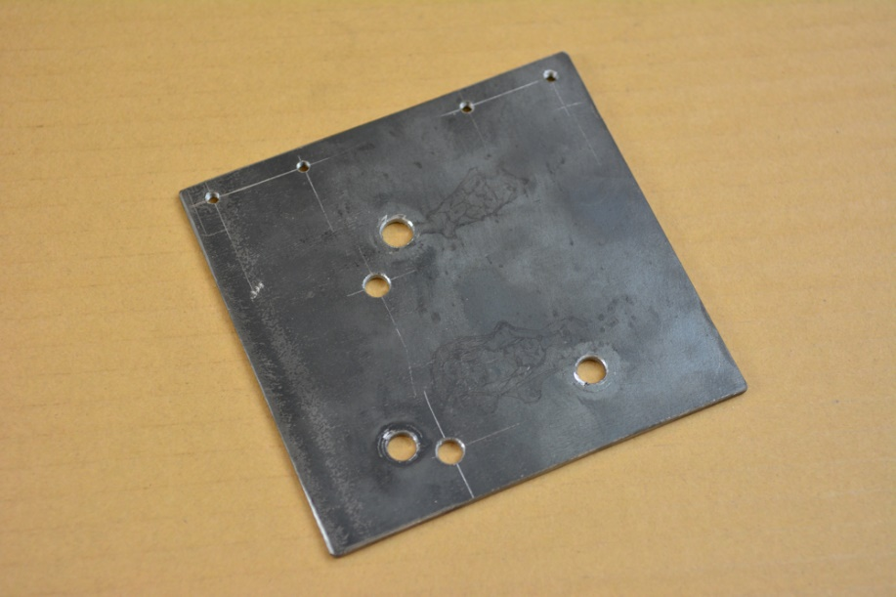
1.3.5 Z mount plate
Quantity: 1 piece
Technical drawing: Z mount plate
1. With angle grinder, cut 3mm thick metal plate dimensions 120x130mm.
2.Measure, mark and drill two 4.2 holes, refer to drawing for dimensions.
1.3.6 Z mount plate - bottom
Quantity: 1 piece
Technical drawing: Z mount plate - bottom
1. With angle grinder, cut 3mm thick metal plate dimensions 120x130mm to length 60mm.
2.Measure, mark and drill 4.2 and five 10mm holes, refer to drawing for dimensions.

Slide 19
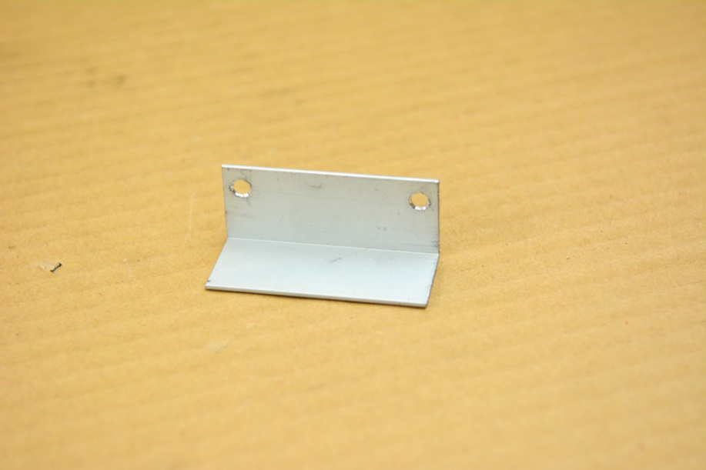
1.3.7 L - bracket
Quantity: 1 piece
Technical drawing: L – bracket
1. Cut 1,5 mm thick metal or Aluminum L profile dimensions 25x25mm .
2.Measure, mark and drill 4.2 and five 10mm holes, refer to drawing for dimensions.

Slide 20
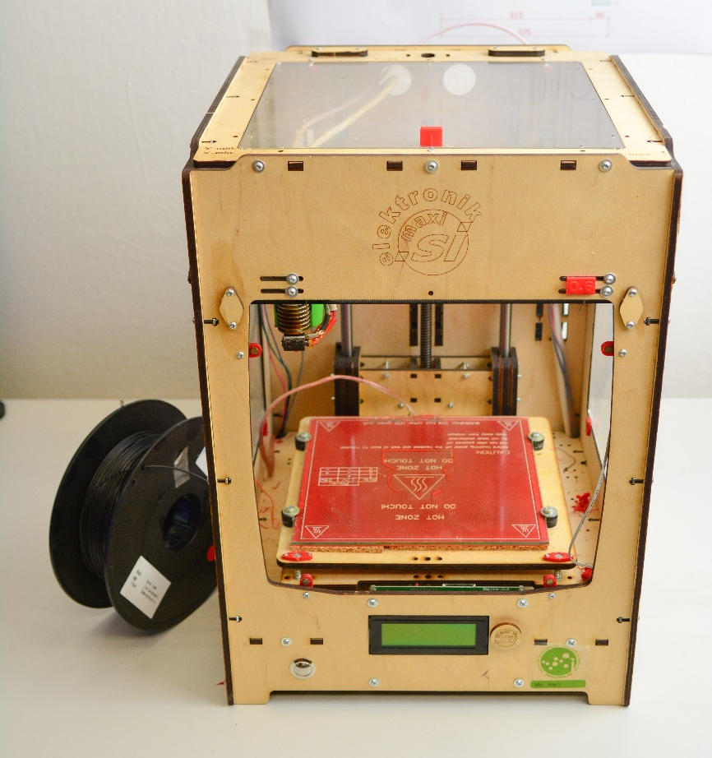
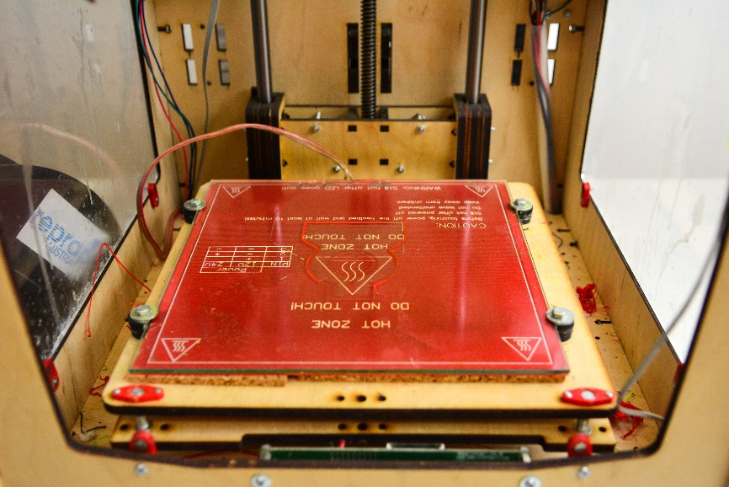
1.4 Printing 3D printed parts
Use 3D printer to print plastic parts needed for construction of CNC plasma cutter. We used Troublemaker - our open source 3D printer based on highly popular printer Ultimaker: http://www.thingiverse.com/thing:263814 with these printing parameters:
- layer_height = 0.2
- wall_thickness = 1.6
- fill_density = 20
- nozzle_size = 0.8
- print_speed = 80

Slide 21
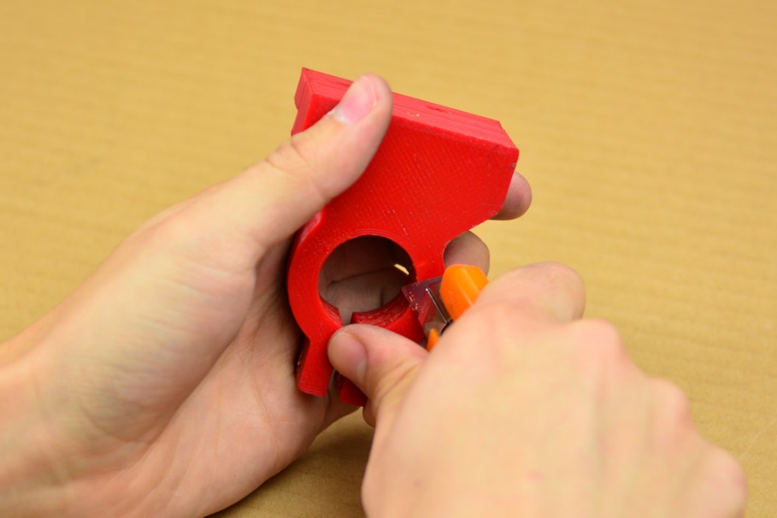
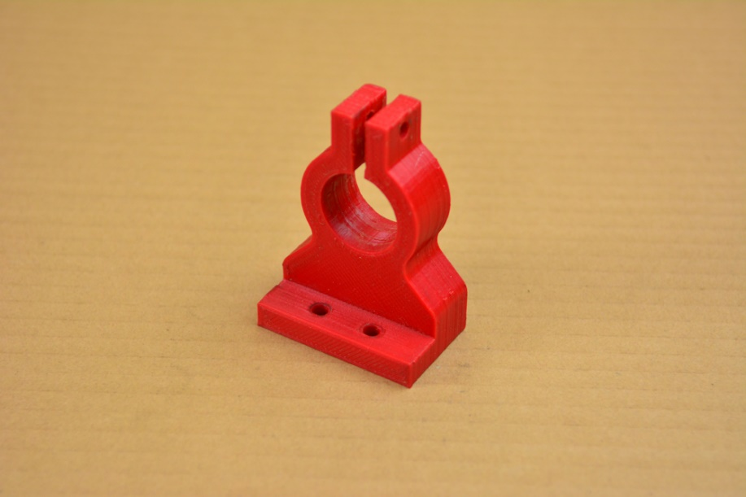
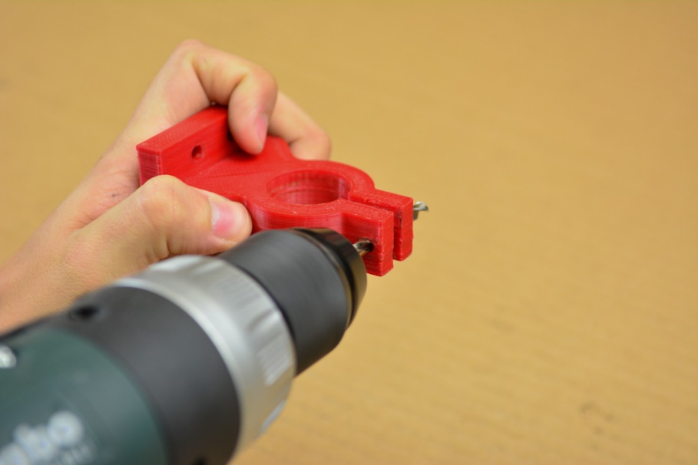
1.4.1 Torch mount
Quantity: 1 piece
Technical drawing: Torch mount
1. 3D print part.
2. Use knife or scalpel, to cut away excess plastic on the edges.
3. Re drill three 5.2 and one 3.5 hole.

Slide 22
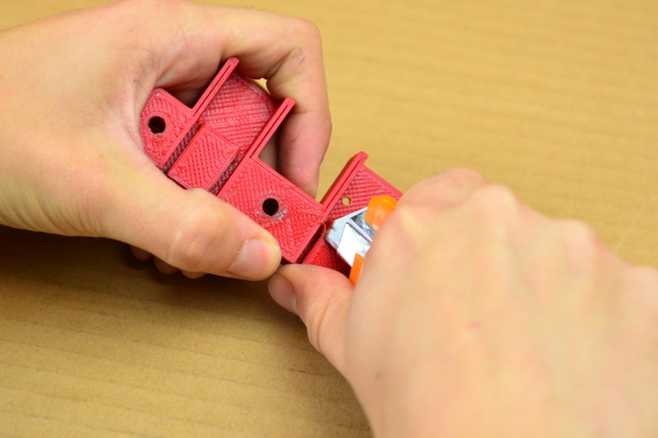
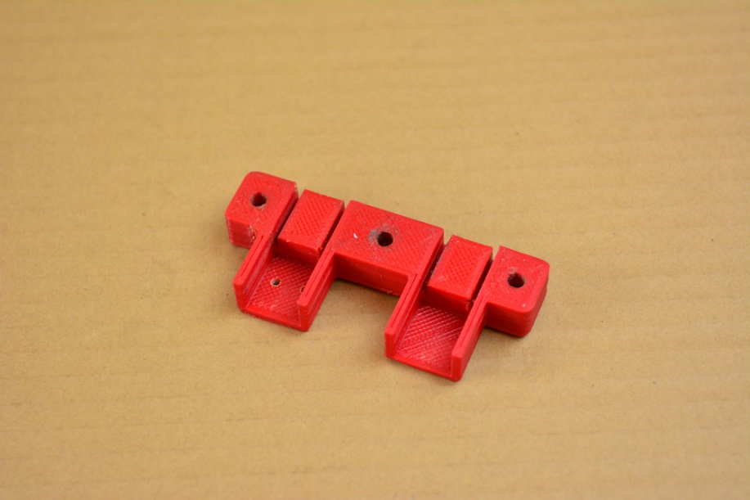
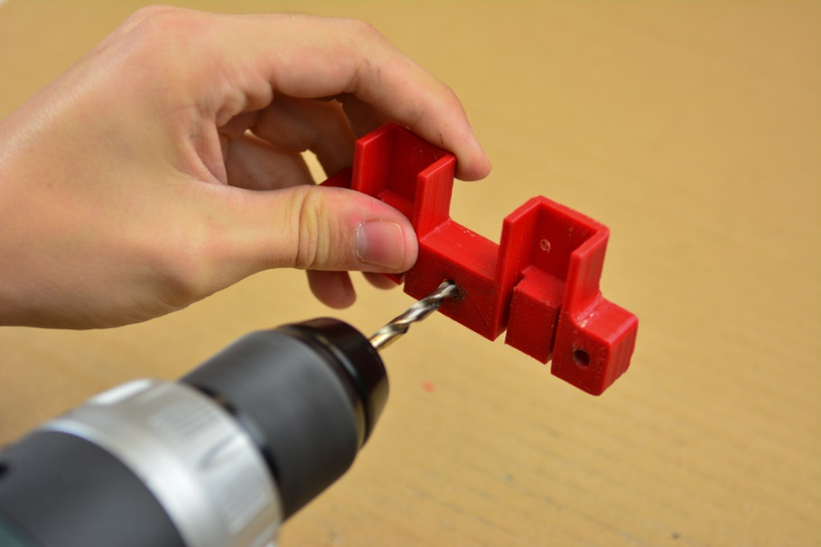
1.4.2 Spring stopper
Quantity: 1 piece
Technical drawing: Spring stopper
1. 3D print part.
2. Use knife or scalpel, to cut away excess plastic on the edges.
3. Re drill three 5.5 mm holes.

Slide 23
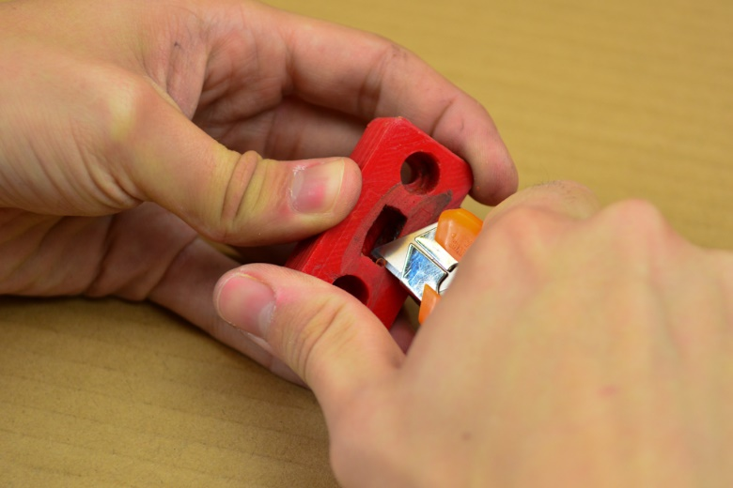
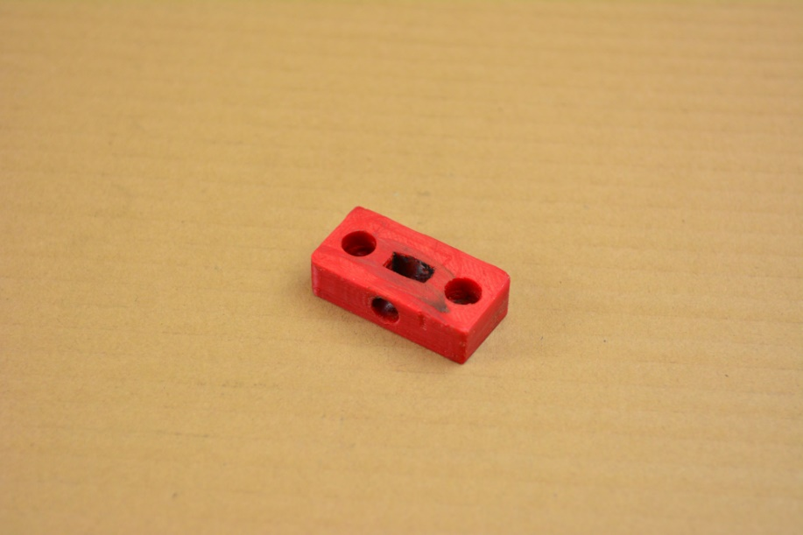
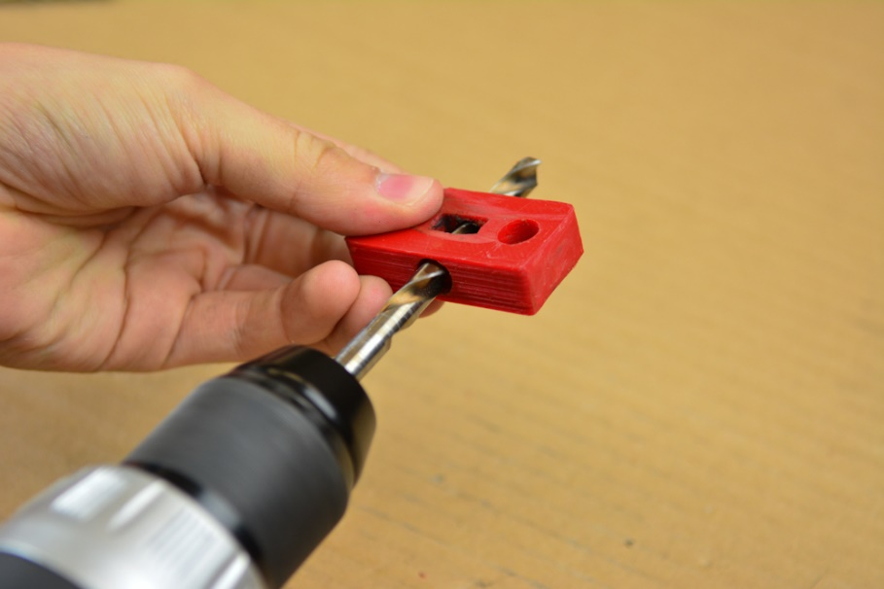
1.4.3 Nut bracket
Quantity: 1 piece
Technical drawing: Nut bracket
1. 3D print part.
2. Use knife or scalpel, to cut away excess plastic on the edges. Make sure M8 nut will fit tightly into nut bracket or reprint part with changed settings.
3. Re drill three 5.5 mm holes.

Slide 24
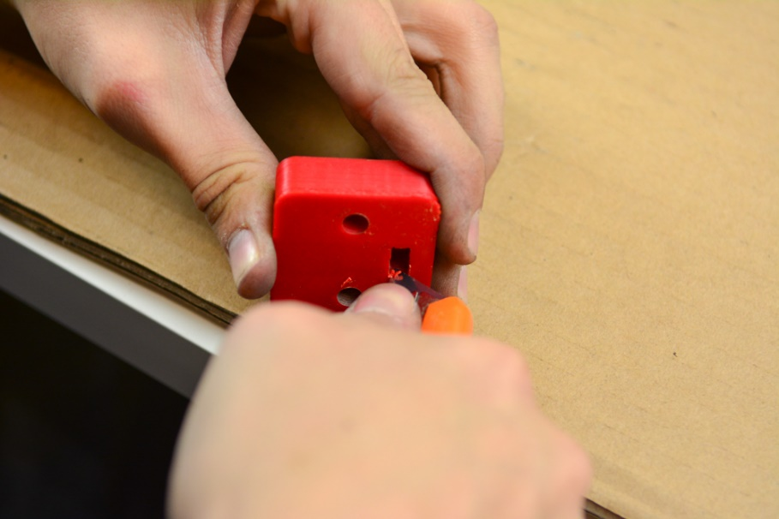
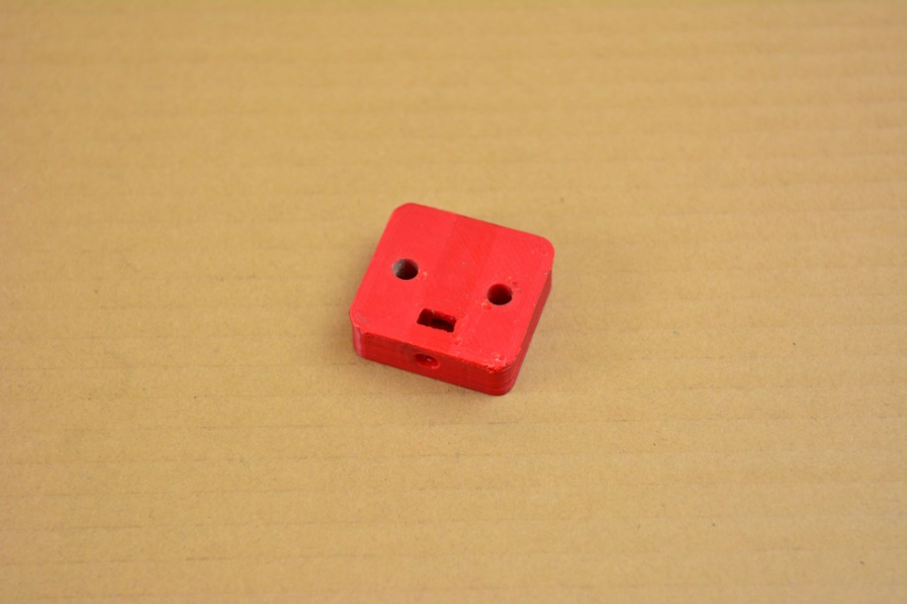
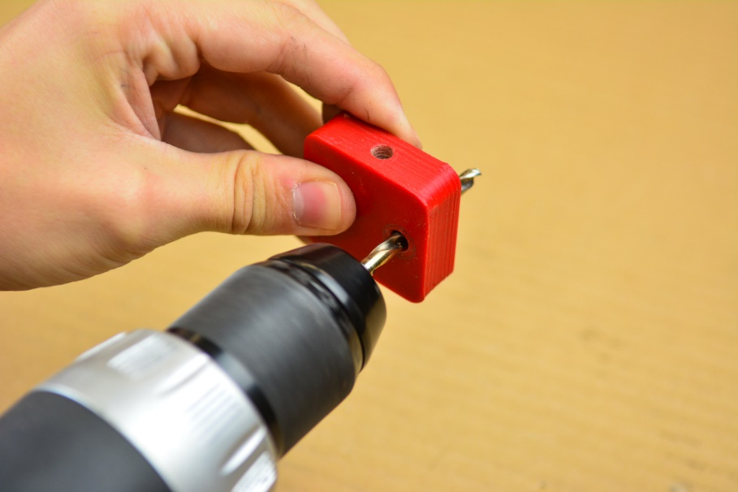
1.4.4 Tightener - outer
Quantity: 6 pieces
Technical drawing: Tightener - outer
1. 3D print part.
2. Use knife or scalpel, to cut away excess plastic on the edges.
3. Re drill three 6mm holes.

Slide 25
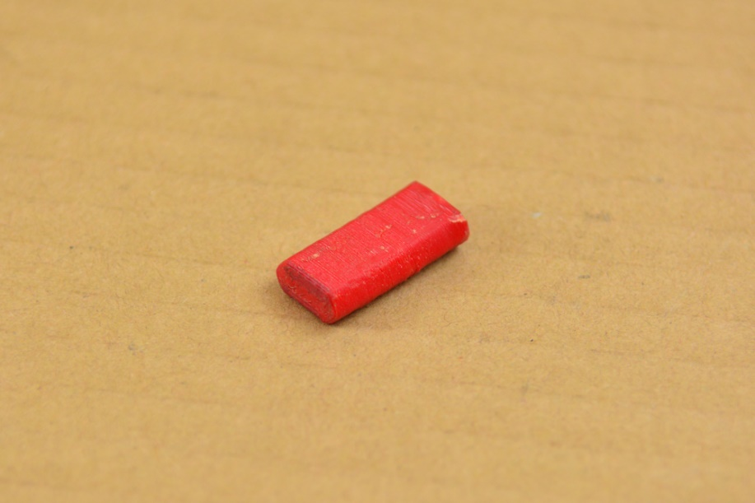
1.4.5 Tightener - inner
Quantity: 6 pieces
Technical drawing: Tightener - inner
3D print part.
2. Use knife or scalpel, to cut away excess plastic on the edges.

Slide 26
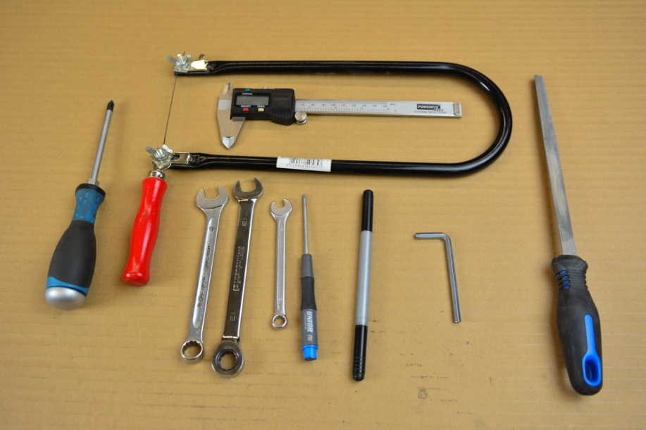
2. Assembly 2.1 Trolley assembly
2.1.1 Trolley - Y
Quantity: 2 pieces
Technical drawing: Trolley Y
Beam Short
Tools:
- Phillips screwdriver
- Torx screwdriver
- Hex screwdriver
- Combination spanner 10, 13
- Hand saw
- Steel file
- Caliper
- Pen

Slide 27
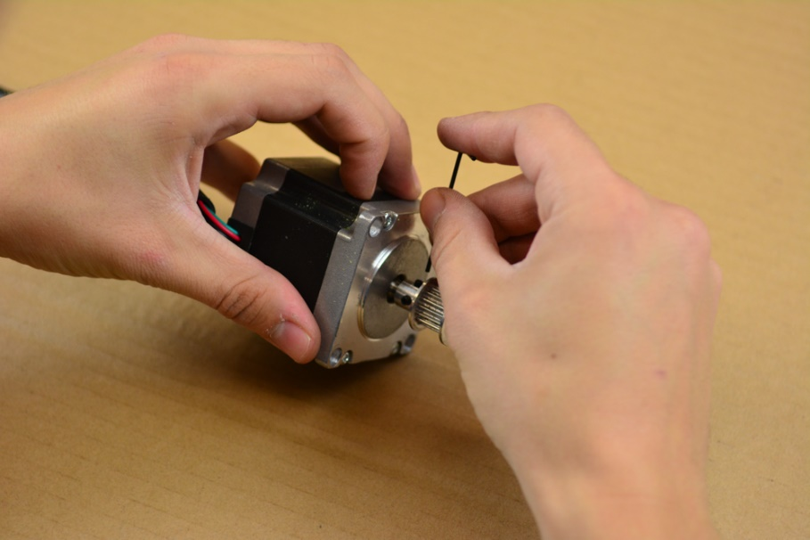

Bill of materials – Trolley - Y
1. Take NEMA 23 Stepper motor and mount timing pully onto motor axis. Distance between motor casing and timing pully edge should be minimal – around 0.5mm.
ITEM NO. | PART NUMBER | DESCRIPTION | QTY.
1 | Beam Short Y1 | SHS 100x100x3x130 | 1
2 | NEMA 23 Stepper motor |  | 1
3 | Timing pulley | Flanged timing pulley | 1
4 | Micro switch |  | 2
5 | Bearing F608Z | Belt Ball Bearing fi22 | 4
6 | Bearing 608ZZ | Ball Bearing fi22 | 6
7 | DIN 933 M8x120 Grade A 8.8 | M8 Hex Bolt | 6
8 | DIN 933 M8x20 Grade A 8.8 | M8 Hex Bolt | 4
9 | DIN 7985 M5x25Grade A2f | Cross screw M5 | 4
10 | DIN 934 M8 8.8 | M8 Hex Nut | 20
11 | DIN 934 M5 8.8 | M5 Hex Nut | 12
12 | DIN 125 8.4 Grade A | M8 Washer Grade A | 10
13 | DIN 127 8.5 | M8 Spring Washer | 12
14 | DIN 7349 5.3 | M5 Washer | 4
15 | DIN 7985 M3x12 Grade A2f | Cross screw M3 | 4
16 | DIN 934 M3 8.8 | M3 Hex Nut | 4
17 | End switch |  | 2

Slide 28




2. Put DIN 7985 M5x25Grade A2f into mounting holes of NEMA 23 Stepper motor. Use washers.
3. Screw four DIN 934 M5 8.8 hex nuts and put two DIN 7349 5.3 washers onto each DIN 7985 M5x25Grade A2f which will serve as spacers between stepper and surface S1 of Beam short Y1.
4. Screw NEMA 23 Stepper motor onto S1 surface of Beam short Y1 with four DIN 7349 5.3 washers and four DIN 934 M5 8.8 nuts.

Slide 29




5. Cut peace of steel (wood or aluminum) 33, 30 and 27mm long and about 10 mm wide. This will be used as a ruler for measuring distance between bearing and inner wall of Beam short Y1.
6. Put screw DIN 933 M8x120 Grade A 8.8 into B1 hole on S4 surface of Beam short Y1 and screw on Bearing 608ZZ using hex nut DIN 934 M8 8.8 with spring washer DIN 127 8.5. Distance from inner S4 surface to bearing should be 30 mm. Distance measure with ruler made in step 5. Screw nut with washer on screw onto surface S2.

Slide 30




7. Put screw DIN 933 M8x120 Grade A 8.8 into F1 hole on S1 surface and repeat procedure from step 6. Distance from inner S1 surface to bearing should be 33 mm.
8. Put screw DIN 933 M8x120 Grade A 8.8 into A2 hole on S4 surface and repeat procedure from step 6. Distance from inner S2 surface to bearing should be 30 mm.

Slide 31



9. Put screw DIN 933 M8x120 Grade A 8.8 into A1 hole on S4 surface and repeat procedure from step 6. Distance from inner S2 surface to bearing should be 30 mm.
10. Put screw DIN 933 M8x120 Grade A 8.8 into B1 hole on S1 surface and put components on in this order: washer DIN 125 8.4 Grade A, then two Bearing F608Z, opposite to each other, washer DIN 125 8.4 Grade A and M8 nut. Then screw on Bearing 608ZZ using two hex nuts DIN 934 M8 8.8 with two spring washers DIN 127 8.5 Distance from inner S3 surface to bearing should be 27 mm.

Slide 32


11. Put screw DIN 933 M8x120 Grade A 8.8 into B2 hole on S1 surface and repeat procedure from step 10. Distance from inner S3 surface to bearing should be 27 mm.
12. In holes B1 and B2 on surface S3 screw in two DIN 933 M8x25 Grade A 8.8 screw. Screw it half way in.

Slide 33



13. In holes C1 and C2 on surface S2 screw in two DIN 933 M8x25 Grade A 8.8 screw. Screw it half way in.
14. In holes A1 and A2 mount end switch with two DIN 7985 M3x12 Grade A2f screws and two DIN 934 M3 8.8 nuts.

Slide 34


15. In holes A3 and A4 mount end switch with two DIN 7985 M3x12 Grade A2f screws and two DIN 934 M3 8.8 nuts.

Slide 35
2.1.1 Trolley - X
Quantity: 1 piece
Technical drawing: Trolley X
Beam Short
Tools:
- Phillips screwdriver
- Torx screwdriver
- Hex screwdriver
- Combination spanner 10, 13
- Hand saw
- Steel file
- Caliper
- Pen

Slide 36

Bill of materials – Trolley – x
Instructions for assembly of trolley - x are the same as for trolley – y, except step 4.1 and 4.2 (steps between 4 and 5):
4.1. Put Z mount plate on S4 surface in a fashion that the holes on beam and metal plate will be aligned.
ITEM NO. | PART NUMBER | DESCRIPTION | QTY.
1 | Beam Short Y1 | SHS 100x100x3x130 | 1
2 | NEMA 23 Stepper motor |  | 1
3 | Timing pulley | Flanged timing pulley | 1
4 | Micro switch |  | 2
5 | Bearing F608Z | Belt Ball Bearing fi22 | 4
6 | Bearing 608ZZ | Ball Bearing fi22 | 6
7 | DIN 933 M8x120 Grade A 8.8 | M8 Hex Bolt | 6
8 | DIN 933 M8x20 Grade A 8.8 | M8 Hex Bolt | 4
9 | DIN 7985 M5x25Grade A2f |  | 4
10 | DIN 934 M8 8.8 | M8 Hex Nut | 20
11 | DIN 934 M5 8.8 | M5 Hex Nut | 12
12 | DIN 125 8.4 Grade A | M8 Washer Grade A | 10
13 | DIN 127 8.5 | M8 Spring Washer | 12
14 | DIN 7349 5.3 | M5 Washer | 4
15 | DIN 7985 M3x12 Grade A2f | Cross screw M3 | 4
16 | DIN 934 M3 8.8 | M3 Hex Nut | 4
17 | End switch |  | 2
18 | Z mount plate | 120x130 | 1
19 | Z mount plate - Bottom | 120x130 | 1

Slide 37

4.2 Put Z mount plate - Bottom on S2 surface in a fashion that the holes on beam and metal plate will be aligned.

Slide 38

2.2 Tightener assembly
2.2.1 Tightener - right assembly
Quantity: 3 pieces
Technical drawing: Tightener - right
Bracket for tighteners
Tools:
- Phillips screwdriver
- Hex screwdriver
- Combination spanner 10, 13

Slide 39


Bill of materials – Tightener – right assembly
*In one piece use DIN 933 M8x120 in one DIN 933 M8x60 and in one DIN 933 M8x20.
1. Put DIN 934 M6 8.8 nut into nut bracket in part Tightener-outer, make sure it fits tightly, if not try cut excess plastic on edges or change printing parameters and repeat 3D print.
ITEM NO. | PART NUMBER | DESCRIPTION | QTY
1 | Bracket for tighteners - right |  | 1
2 | Tightener - outer |  | 1
3 | Tightener - inner |  | 1
4 | DIN 912 M6x25 |  | 1
5 | DIN 933 M8x120 |  | 1*
6 | DIN 933 M8x60 |  | 1*
7 | DIN 933 M8x20 |  | 1*
8 | DIN 7985 M6x25 Grade A2f | Cross screw M6 | 1
9 | DIN 934 M6 8.8 | M6 Hex Nut | 3

Slide 40


2. Screw in DIN 912 M6x25 on nut from step two in part Tightener outer.
3. Put two DIN 7985 M6x25 Grade A2f screws in holes on 3D printed part Tightener – outer like shown in picture.

Slide 41


4. Screw part Tightener – outer on bracket for tighteners – right on S1 surface with two DIN 934 M6 8.8 nuts. When screwing don't screw it tightly, leave gap. 2mm large gap, for mounting timing belt later.
5. Screw in DIN 933 M8x120 on two assembled parts Tightener - right which will serve as stopper for end switch for Y axis.

Slide 42


6. Screw in DIN 933 M8x120, DIN 933 M8x60 and DIN 933 M8x20 on one assembled part Tightener - right which will serve as stopper for end switch for X axis.
7. Put part Tightener – inner in hole on part Tightener – outer.

Slide 43
2.2.2 Tightener - left assembly
Quantity: 3 pieces
Technical drawing: Tightener - left
Bracket for tighteners
Tools:
- Phillips screwdriver
- Hex screwdriver
- Combination spanner 10, 13

Slide 44
Bill of materials – Tightener – left assembly
*In one piece use DIN 933 M8x120 in one DIN 933 M8x60 and in one DIN 933 M8x20.
1. Put DIN 934 M6 8.8 nut into nut bracket in part Tightener-outer, make sure it fits tightly, if not try cut excess plastic on edges or change printing parameters and repeat 3D print.
ITEM NO. | PART NUMBER | DESCRIPTION | QTY
1 | Bracket for tighteners - right |  | 1
2 | Tightener - outer |  | 1
3 | Tightener - inner |  | 1
4 | DIN 912 M6x25 |  | 1
5 | DIN 933 M8x120 |  | 1*
6 | DIN 933 M8x60 |  | 1*
7 | DIN 933 M8x20 |  | 1*
8 | DIN 7985 M6x25 Grade A2f | Cross screw M6 | 1
9 | DIN 934 M6 8.8 | M6 Hex Nut | 3

Slide 45
2. Screw in DIN 912 M6x25 on nut from step two in part Tightener outer.
3. Put two DIN 7985 M6x25 Grade A2f screws in holes on 3D printed part Tightener – outer like shown in picture.

Slide 46
4. Screw part Tightener – outer on bracket for tighteners – left on S1 surface with two DIN 934 M6 8.8 nuts. When screwing don't screw it tightly, leave gap. 2mm large gap, for mounting timing belt later.
5. Screw in DIN 933 M8x120 on two assembled parts Tightener - right which will serve as stopper for end switch for Y axis.

Slide 47

6. Screw in DIN 933 M8x120, DIN 933 M8x60 and DIN 933 M8x20 on one assembled part Tightener - left which will serve as stopper for end switch for X axis.
7. Put part Tightener – inner in hole on part Tightener – outer.

Slide 48
2.3 Frame assembly
Quantity: 1 piece
Technical drawings: Plasma frame assembly
Beam Y
Beam X1
Beam X2
Beam X main
Bracket for tighteners – right
Bracket for tighteners – left
Tools:
- Phillips screwdriver
- Hex screwdriver
- Combination spanner 10, 13

Slide 49


Bill of materials – Frame assembly
1. Put Beam X1 and Beam X2 onto assembly table approximately 1160mm apart to each other in a fashion that surfaces S4 of both parts will be oriented to each other. S1 surfaces should be oriented upwards. See picture.
ITEM NO. | PART NUMBER | DESCRIPTION | QTY
1 | Beam X - Main |  | 1
2 | Beam X1 |  | 1
3 | Beam X2 |  | 1
4 | Beam Y |  | 2
5 | Trolley X |  | 1
6 | Trolley Y |  | 2
7 | Tightener - right |  | 3
8 | Tightener - left |  | 3
10 | DIN 933 M8x100 Grade A 8.8 | M8 Hex Bolt | 4
11 | DIN 933 M8x60 Grade A 8.8 | M8 Hex Bolt | 10
12 | DIN 933 M8x55 Grade A 8.8 | M8 Hex Bolt | 2
13 | DIN 933 M8x50 Grade A 8.8 | M8 Hex Bolt | 2
14 | DIN 934 M8 8.8 | M8 Hex Nut | 18
15 | DIN 125 8.4 |  | 10
16 | Turnbuckle M6 | M6 2x Eye70 mm | 2

Slide 50


2. Take one trolley Y and put on Beam Y. Surface S1 of Beam for trolley (where motor is mount) should be oriented together with surface S4 of Beam Y.
3. Take second trolley Y and put on another Beam Y. Surface S1 of Beam for trolley (where motor is mount) should be oriented together with surface S2 of Beam Y.

Slide 51



4. Put both Beam Y with trolleys on prepared X1 and X2 beams in a fashion that both motors will facing outwards of the frame and that the holes for mounting turnbuckle will be in the same corner.
5. Mount together first corner of the frame with DIN 933 M8x100 Grade A 8.8 screw, DIN 934 M8 8.8 nut and DIN 125 8.4 washer. Before screwing put tightener on top of the Beam Y. Make sure that tighteners are facing outwards of the construction and to each other – see picture.

Slide 52


6. Proceed with screwing three remaining corners with tighteners.
7. With DIN 933 M8x60 Grade A 8.8 screws, DIN 934 M8 8.8 nuts and DIN 125 8.4 washers mount both turnbuckles in the corners, use designated holes A3 and A4 on Beam X2 and B1 on Beam Y.

Slide 53




8. Screw turnbuckles to achieve parallelism of frame. Use carpenter meter for measurements.
9. Put Trolley X on Beam X – Main. Surface S1 of Beam for trolleys (surface where motor is mount) should be at the same side as surface S2 of Beam X – Main.
10. Mount Beam X – Main to the Y Trolleys in a manner that motor will face Beam X1. Before screwing put on tighteners like shown in picture. For holes A1 and A2 use two DIN 933 M8x55 Grade A 8.8 screws, DIN 934 M8 8.8 nut and DIN 125 8.4 washer, for holes B1 and B2 use two DIN 933 M8x50 Grade A 8.8 screws and DIN 934 M8 8.8 nut.

Slide 54


11. Feed timing belt into the trolleys and secure them onto the tighteners.
12. Tighten timing belts with M6 screw on tighteners.

Slide 55
2.4 Z axis assembly
Quantity: 1 piece
Technical drawings: Z axis
Tools:
- Phillips screwdriver
- Hex screwdriver
- Combination spanner 10, 13

Slide 56
Bill of materials – Z axis assembly
ITEM NO. | PART NUMBER | DESCRIPTION | QTY
1 | Linear guide – big |  | 2
2 | Linear guide – small |  | 2
3 | Base plate |  | 1
4 | Mounting plate for small guides |  | 1
5 | Fixing plate |  | 1
6 | spring stopper |  | 1
7 | motor mount |  | 1
8 | nut bracket |  | 1
9 | Torch mount |  | 1
10 | pusa |  | 1
11 | Coupler 5 to 8 mm | Flexible shaft coupler | 1
12 | Hinge 40x40 |  | 4
13 | M8 Rod | Threaded rod M8 | 1
14 | DIN 934 M8 8.8 | M8 Hex Nut | 1
15 | DIN 934 M4 8.8 | M4 Hex Nut | 25
16 | DIN 934 M3 8.8 | M3 Hex Nut | 4
17 | DIN 125 4.3 Grade A | M4 Washer Grade A | 17
18 | DIN 562 M4 | M4 square thin nut | 23
19 | DIN 7985 M5x25 Grade A2f |  | 1
20 | DIN 934 M5 8.8 | M5 Hex Nut | 1
21 | DIN 912 M6x20 |  | 2
22 | DIN 125 6.4 Grade A | M6 Washer Grade A | 2
23 | DIN 934 M6 8.8 | M6 Hex Nut | 2
24 | NEMA 17 Stepper Motor |  | 1
25 | DIN 7985 M3x12 Grade A2f | Cross screw M3 | 4
26 | DIN 912 M4x12 |  | 8
27 | DIN 912 M4x16 |  | 6
28 | DIN ISO 7049 8x22 |  | 1
29 | stopper for torch mount |  | 1
30 | DIN 912 M4x8 |  | 14
31 | DIN 912 M4x25 |  | 1
32 | Micro end switch |  | 3
33 | trigger for end switch |  | 2
34 | L - bracket |  | 2
35 | DIN 7985 TX M3x10 | Torx screw M3 | 6

Slide 57


1. If dimensions of Linear guide – big is not the same as used, cut inner casing of linear guide – big to 310 mm and outer casing of linear guide – big as well. You should use guides with the same profile dimensions.
2. If dimensions of Linear guide – small is not the same as used, cut inner casing of linear guide – small to 100mm and outer casing of linear guide – small to 120mm. You should use guides with the same profile dimensions.
3 Mount four Hinge 40x40 to base plate in threaded holes using DIN 912 M4x8. Replace two hinge axis with custom made coppers as shown in picture for easy removing of Z axis. Do not put it yet in.

Slide 58




4. With four DIN 912 M4x12 screws and DIN 562 M4, screw both Linear guides – big to the Base plate. Locking side of mechanism should be at the cutout for the coupler. Use DIN 125 4.3 Grade A washers and DIN 562 M4 nuts as spacers.
5. Mount Torch mount on the Fixing plate with two DIN 912 M4x16 screws and DIN 934 M4 8.8 nuts from the front side and one wood screw DIN EN ISO 70459 4.8 from behind.

Slide 59



6. In 5,2mm hole on Torch mount screw in DIN 7985 M5x25, do not tighten screw already. If screw does not fit, redrill hole to 5,2 mm.
7. With four DIN 912 M4x16 and DIN 562 M4 mount Fixing plate with Torch mount to the Linear guides – small inner. Use two DIN 934 M4 8.8 and one DIN 562 M4 as a spacer between Linear guides and fixing plate.

Slide 60



8. Mount Linear guides – small outer to the Mounting plate for small guides with stopper for torch mount. Screw two DIN EN ISO 7045 M4x8 on the bottom of plate. Use DIN 562 M4 square nut. Put between L profile that will serve as stopper for small guides.
9. Put DIN 934 M8 8.8 into the Nut bracket, make sure it fits tightly, if not try cut excess plastic on edges or change printing parameters and repeat 3D print.

Slide 61


10. Mount Nut bracket to the Mounting plate for small guides. Use DIN 912 M6X20 with DIN 934 M6 and DIN 125 6.4. Be sure that head of the screw is all the way hidden in nut bracket.
11. Mount Mounting plate for small guides to the inner casing of Linear guide – big. First screw two DIN 912 M4x12 screws at the bottom of the plate with two DIN 125 4.3 Grade A, put DIN 125 4.3 Grade A washer to the head of the screw. Between plate and guides put DIN 934 M4 8.8 nut and DIN 125 4.3 Grade A washer. Screw all with DIN 562 M4 square nut.

Slide 62




12. Move Linear guide – big to the other side of the plate and screw Mounting plate for small guides on the other side of the guides.
13. Mount Spring stopper to the Mounting plate for small guides. Put in Spring 12x19x0.75. Use DIN EN ISO 7045 M4x25.

Slide 63


14. Mount micro end switch on the spring stopper, use two DIN 7985 TX M3x10.
15. Mount two L brackets in the designated holes on base plate. Use DIN 912 M4x8 screws.

Slide 64



16. Screw M8 rod into nut bracket as shown in picture.
17. Mount NEMA 17 Stepper motor to the motor mount using DIN 7985 M3x10 Grade A2f screws. Use four DIN 562 M4 as spacers.

Slide 65


18. Mount base plate with NEMA 17 Stepper motor to the L brackets.
19. Put coupler to the motor axis and fix M8 rod to it.

Slide 66



20. Mount two micro end switch in the designated holes using DIN 7985 TX M3x10 and DIN 934 M3 8.8
21. Put hinges with custom made axis in bottom hinges.

Slide 67




22. Mount assembled Z axis to the X trolley using DIN 912 M4x8 screws and DIN 934 M4 8.8.

Slide 68





